Slide 1
JERITA D
Final Project
3/21/2024 Annual Review

Slide 2
PROJECT TITLE
IMAGE SEGMENTATION ON
PANCREAS CT DATA
3/21/2024 Annual Review

Slide 3


AGENDA
Problem Statement
Project Overview
Who are the end users?
Solutions and value of propositions
WOW factor in the solution
Modelling
Results
3/21/2024 Annual Review

Slide 4

PROBLEM STATEMENT
To develop an accurate image segmentation system for delineating the pancreas region in CT (Computed Tomography) scans. This involves collecting a diverse dataset of CT images containing the pancreas, preprocessing the images to enhance quality, annotating them with ground truth labels, and then developing a segmentation algorithm, possibly based on deep learning architectures like U-Net or Mask R-CNN. Training the model with the annotated data, validation, and testing are crucial steps, and post-processing techniques may be applied for refinement. Collaborating with medical experts for clinical validation and adhering to ethical and privacy regulations are paramount. The project aims to produce a valuable tool for medical professionals, contributing to improved diagnosis and patient care.
3/21/2024 Annual Review

Slide 5

PROJECT OVERVIEW
This project aims to develop a robust image segmentation system for accurately delineating the pancreas region in CT scans. Using deep learning techniques, we process and analyze a diverse CT dataset, training a model to identify the pancreas. Our goal is to provide a valuable tool for healthcare professionals, improving diagnostic accuracy and patient care in pancreas-related conditions.
3/21/2024 Annual Review

Slide 6

WHO ARE THE END USERS?
Medical professionals and researchers in radiology, oncology, gastroenterology, and other fields may utilize the image segmentation system to delineate the pancreas in CT images. End users may include:
Radiologists
Cancer specialists
Surgeons.
4. Medical Researchers
5. Healthcare Institutions
The image segmentation system's users are a varied set of healthcare professionals and researchers working to improve pancreatic disease detection and treatment, which benefits patients by enabling more accurate and timely therapies.
3/21/2024 Annual Review

Slide 7

YOUR SOLUTION AND ITS VALUE PROPOSITION
The CT scan pancreas image segmentation method is robust and offers various appealing benefits. The technology accurately segments the pancreas using cutting-edge deep learning methods like U-Net or Mask R-CNN to identify and analyse pancreatic features in CT images. This precision helps healthcare providers make better pancreas-related decisions and provide better patient care. The segmentation procedure is automated, saving time and maximizing healthcare resource use. Segmented pictures provide detailed anatomical information for tailored patient treatment planning, helping surgeons plan operations more precisely and effectively. Additionally, the method helps medical researchers analyze big datasets and improve pancreatic disease understanding and treatment. The system ensures clinical validity, compliance, and patient privacy through collaboration with medical specialists and ethical and regulatory norms, making it an essential tool in medical imaging and healthcare delivery.
3/21/2024 Annual Review

Slide 8

THE WOW IN YOUR SOLUTION
The wow factor in our solution lies in its ability to revolutionize pancreatic image segmentation in CT scans through advanced deep learning techniques. By harnessing the power of state-of-the-art algorithms like U-Net or Mask R-CNN, our system achieves unparalleled accuracy and precision in delineating the pancreas region. This exceptional level of performance not only enhances diagnostic accuracy but also significantly improves patient care by enabling earlier detection and more precise treatment planning for pancreatic conditions. Moreover, the system's automation of the segmentation process reduces manual effort and time, streamlining workflow efficiency and maximizing resource utilization in healthcare settings. With its potential to transform medical imaging practices and contribute to breakthroughs in pancreatic disease research, our solution represents a groundbreaking advancement at the intersection of technology and healthcare.
3/21/2024 Annual Review

Slide 9
MODELLING
Data Collection
Data Preprocessing: Enhance image quality, standardize resolution, and normalize intensity levels to prepare the dataset for analysis.
Model Selection: Choose an appropriate deep learning architecture for image segmentation, such as U-Net or Mask R-CNN.
Model Training: Train the selected model using the annotated dataset, optimizing hyperparameters for accuracy.
Validation: Assess model performance on a separate validation dataset, fine-tuning as necessary to ensure accurate segmentation.
Testing: Evaluate the model's performance on a test dataset using relevant metrics, including Dice coefficient and IoU.
Post-processing: Apply post-processing techniques to improve segmentation results, addressing any artifacts or imperfections.
Clinical Validation: Collaborate with medical professionals to clinically validate the accuracy and reliability of the segmentation results.
Documentation: Document the entire procedure, including dataset details, preprocessing steps, model architecture, training parameters, and evaluation metrics.
Ethical Compliance: Ensure compliance with ethical standards and patient data privacy regulations throughout the project.
3/21/2024 Annual Review

Slide 10
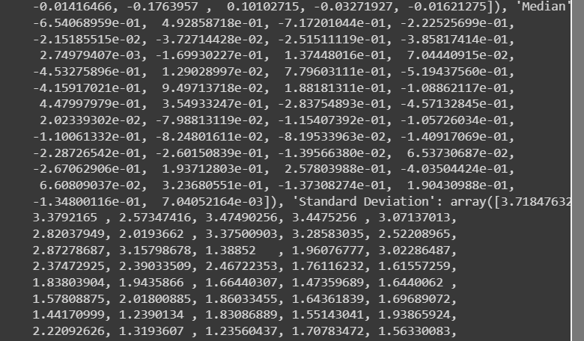
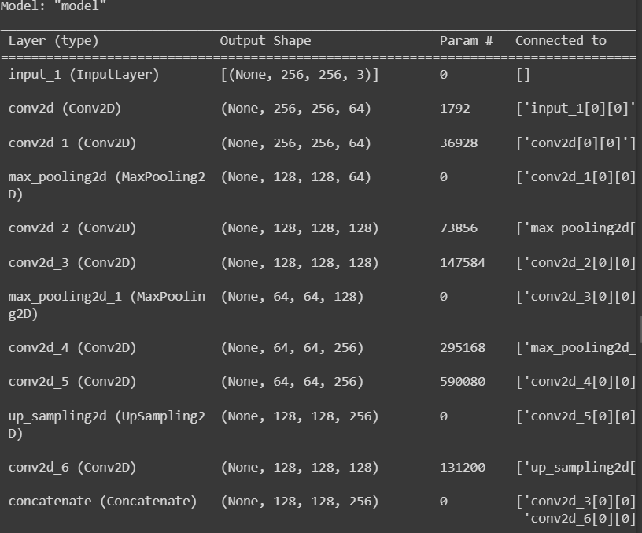
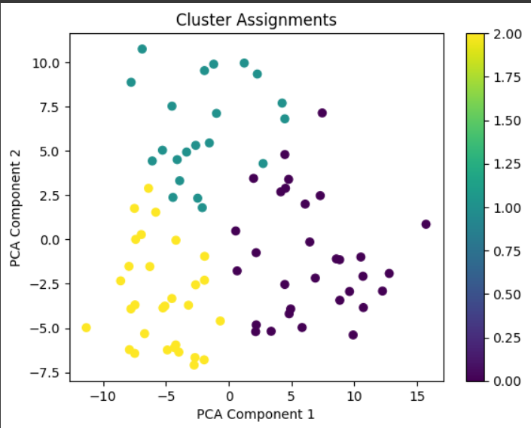
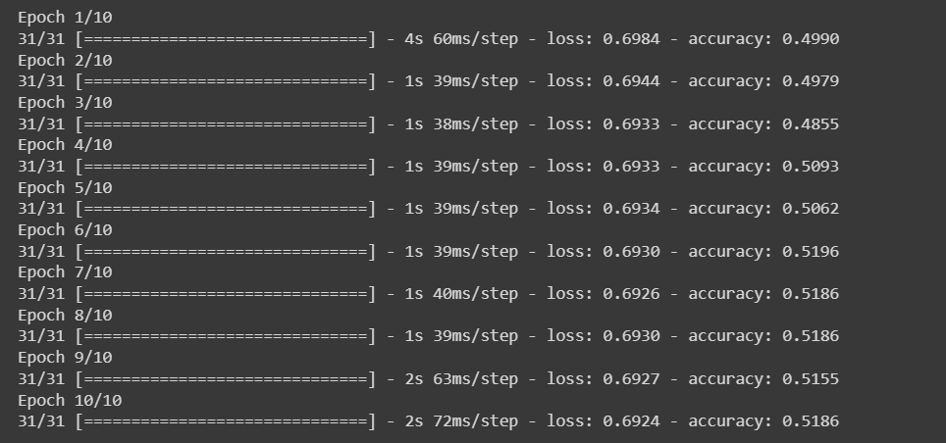
RESULTS
3/21/2024 Annual Review

